Slide 1
Energy in Times of Crisis
Member State Briefing on the Clean Energy Challenge
15 September 2020

Slide 2
HE Ms. Marianne Hagen Norwegian Deputy Minister of Foreign Affairs
Opening Remarks

Slide 3
Mr. Raouf Mazou UNHCR Assistant High Commissioner for Operations
Introductory Remarks

Slide 4
Update on the Clean Energy Challenge
Thomas Fohgrub
Head of the Global Plan of Action for Sustainable Energy in Displacement Settings (GPA) Secretariat, UNITAR

Slide 5
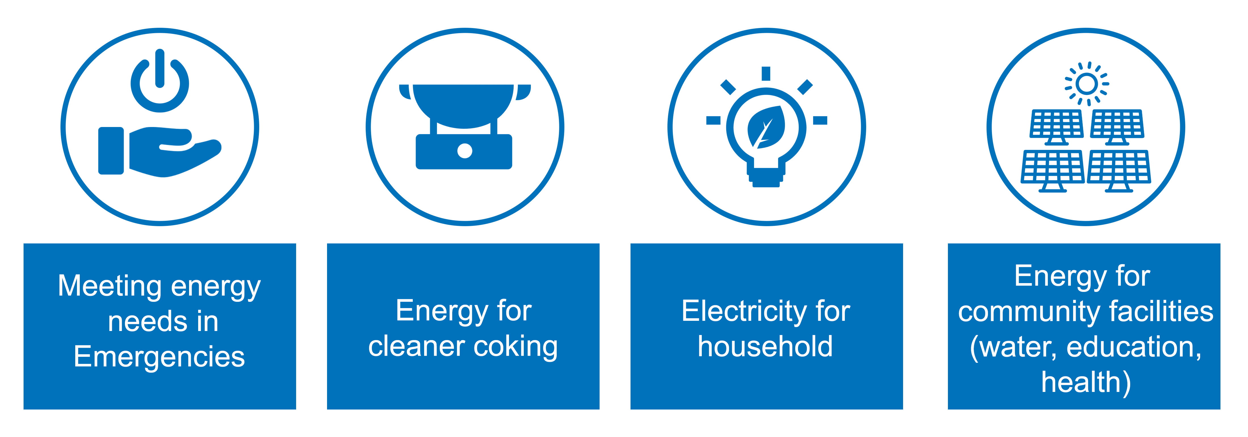
Outcome Areas of the Clean Energy Challenge

Slide 6
Work streams of the CEC in 2020/2021
DATA
Fundraising / Financing
Project Pipeline(s)

Slide 7
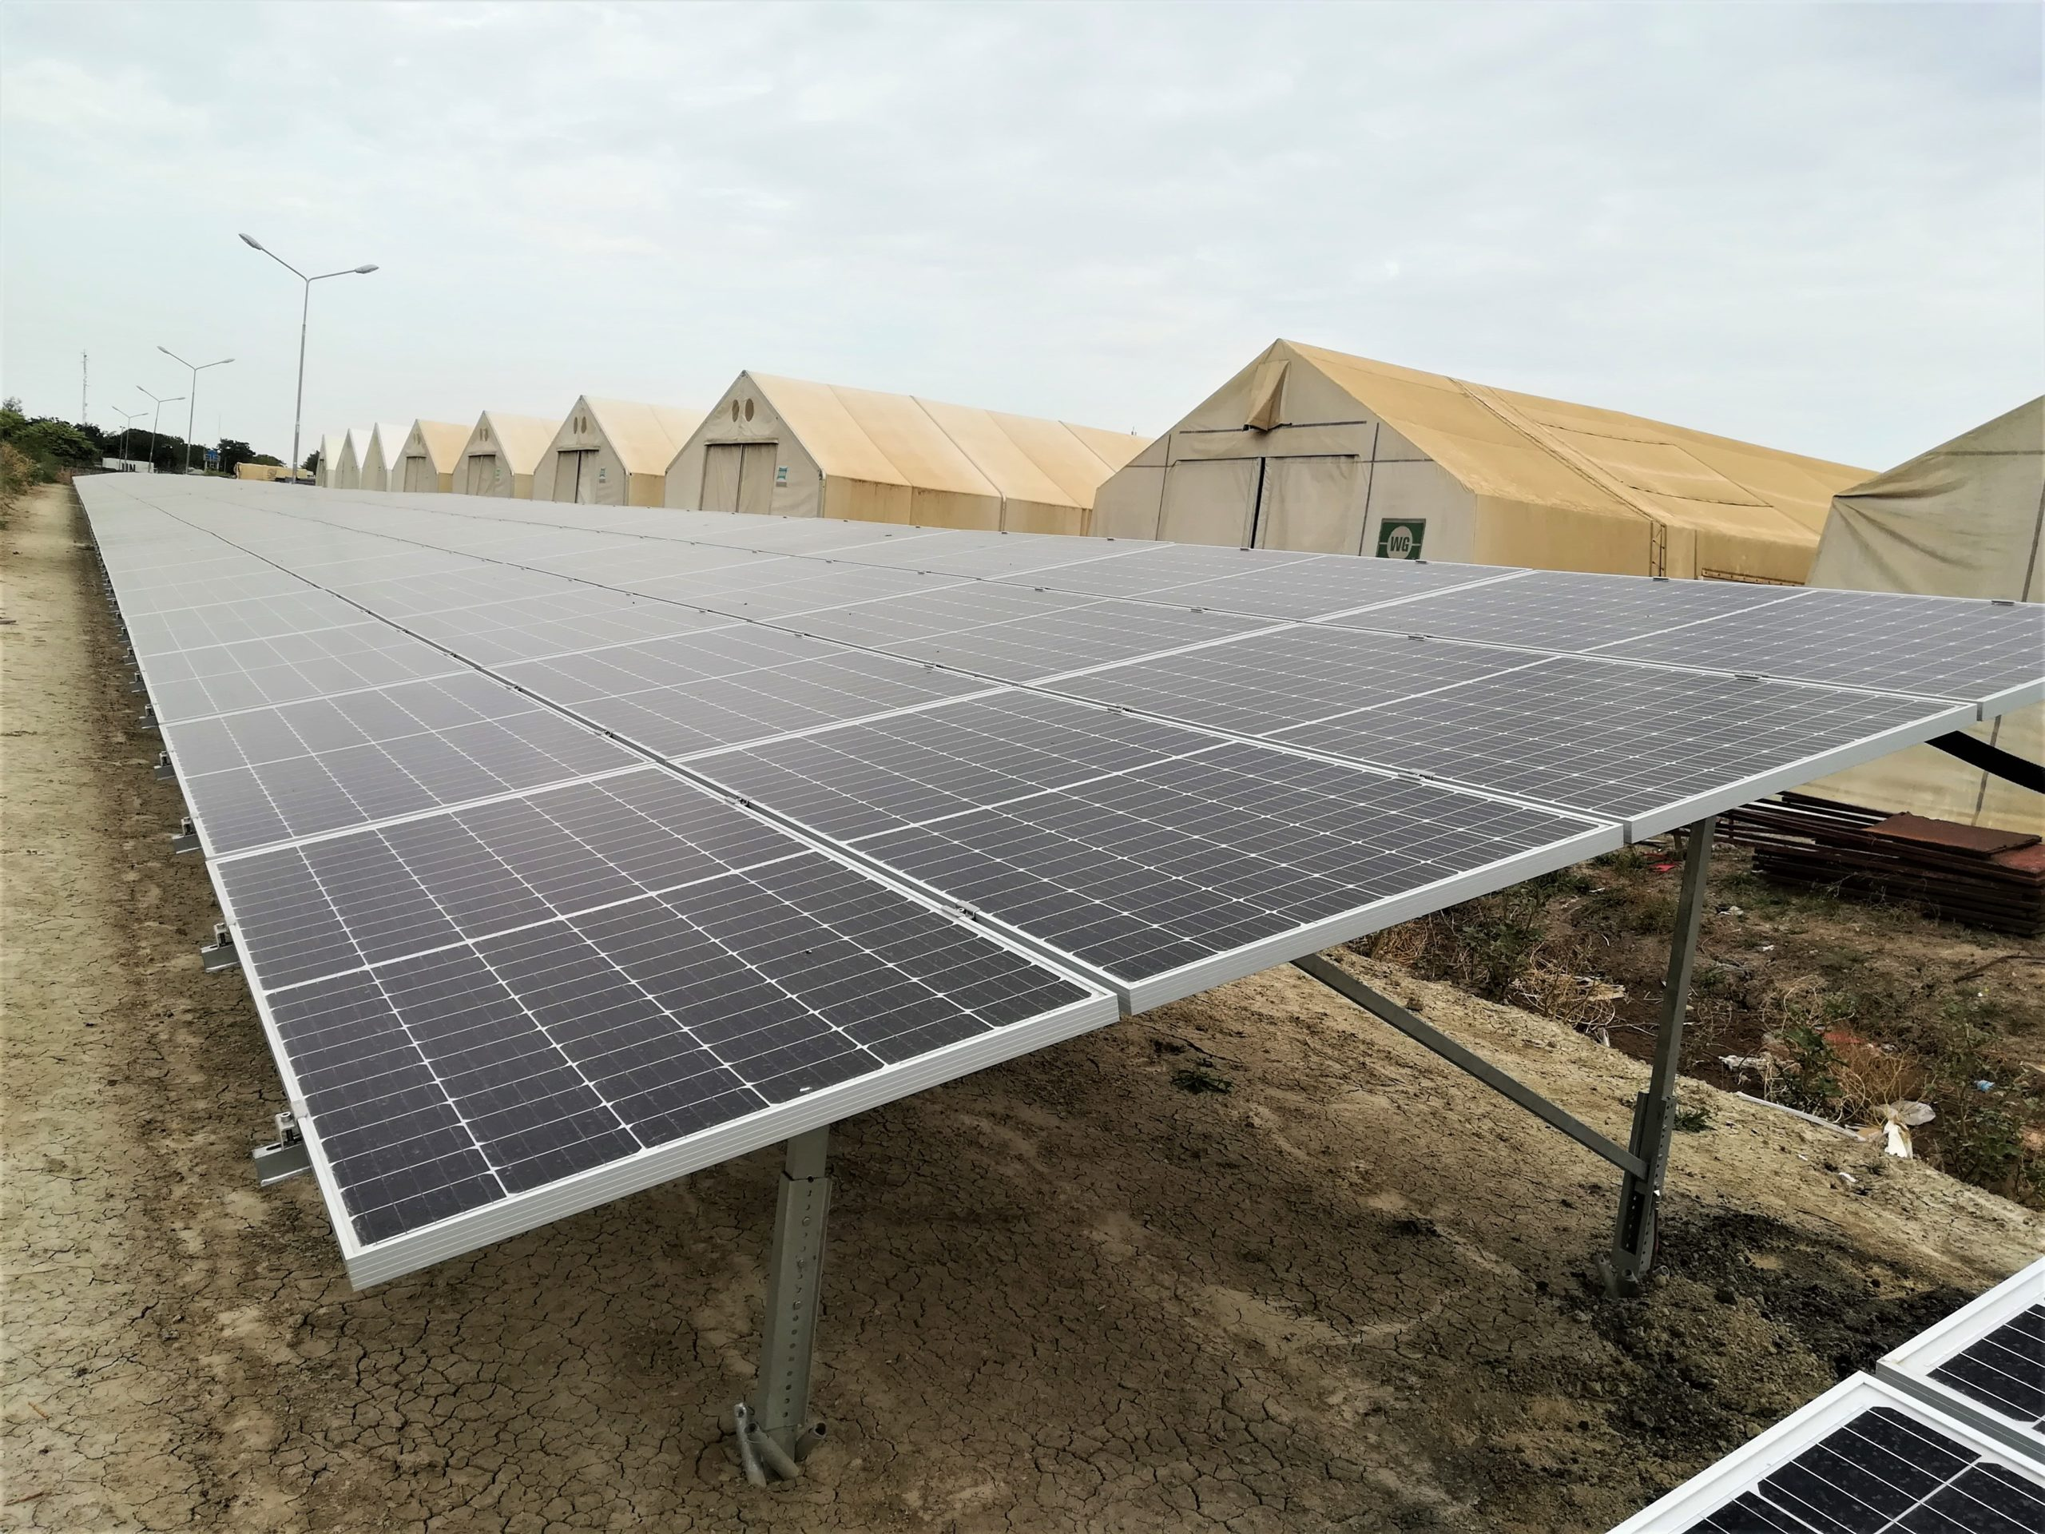
Good practice I: IOM, Scatec Solar – Humanitarian Hub in Malakal, South Sudan
First large scale public-private project
PV capacity of 700 kWp, combined 1,368 kWH battery energy
Reduction of at least 80% diesel
Supported by DFID

Slide 8
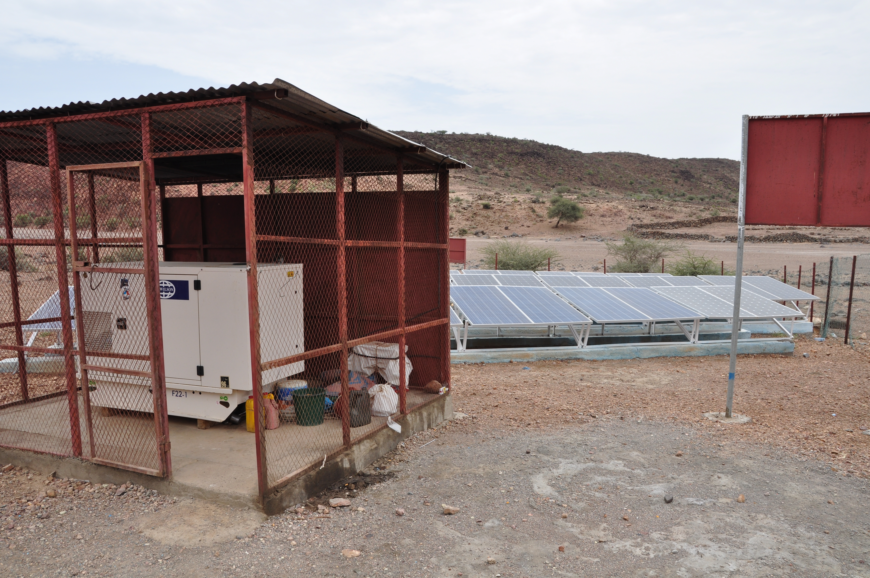
Good practice II: UNHCR, Djibouti
All settlements operated by UNHCR will be solar-powered
Return of investment in 3-4 years
Country plan for additional activities developed
Supported by Germany​

Slide 9
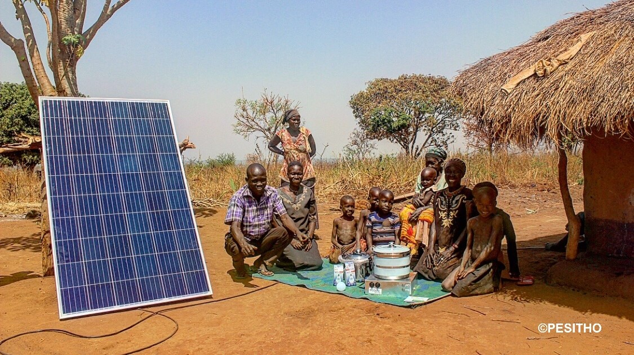
Good practice III: WFP, Pesitho – E-Cooking Burundi
ECOCA: flame-free E-Cooker
Batteries included
First trials with “WFP Innovation”

Slide 10
COVID-19 and Sustainable Energy in Displacement
Jaime de Bourbon de Parme
UNHCR Senior Advisor for Private Sector Partnerships

Slide 11
Why do we need sustainable energy in displacement settings?
Links to COVID19 Response
Powering Health
Facilities
Cleaner
Cooking
Water and Hygiene
Security, Communication & Livelihoods

Slide 12
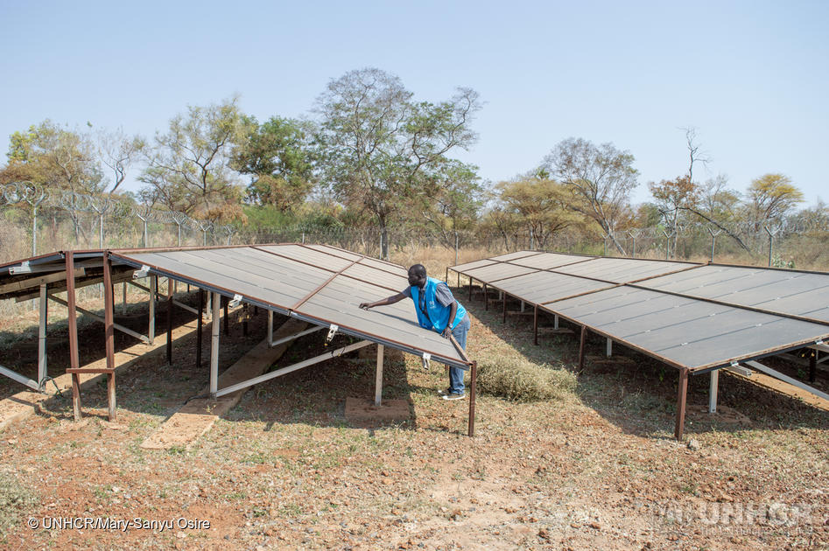
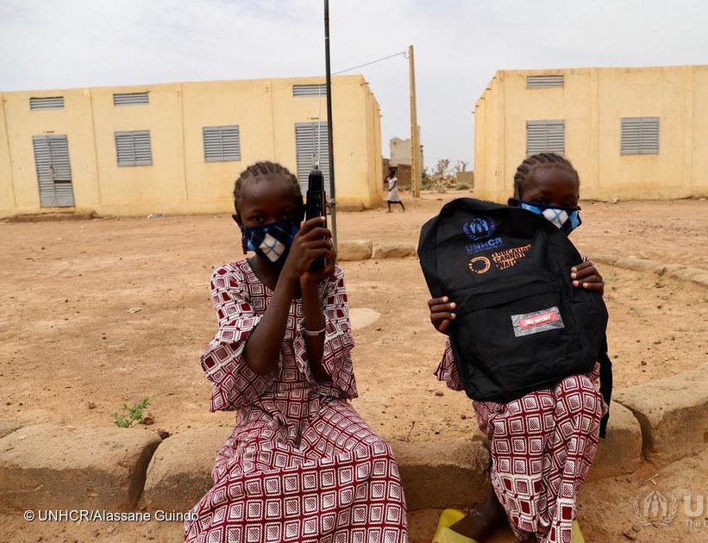

Slide 14
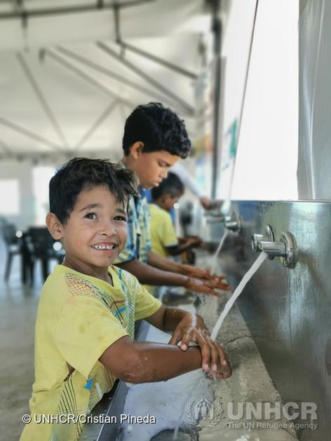
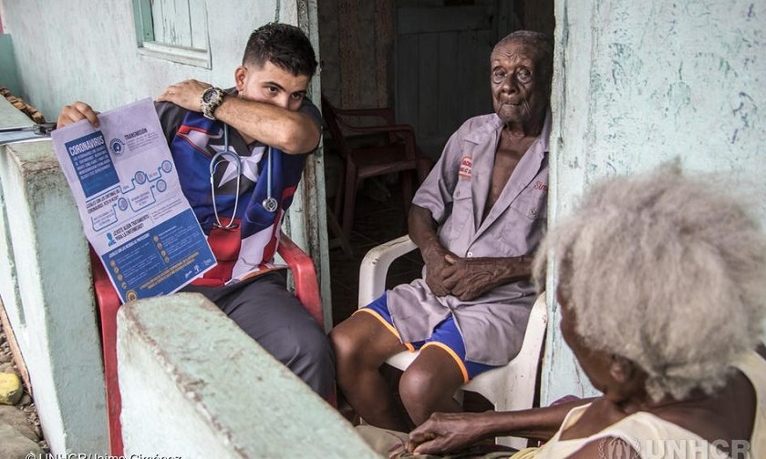

Slide 15
Andrew Harper Special Advisor on Climate Action, UNHCR
Long-term outlook: The global climate crisis

Slide 16
Donor Government
Call to Action
Short Term
Long Term
Host Government
Galvanize the remaining available funding for clean energy and WASH projects in 2020
Expand development work
Include refugees in national energy and develop. planning
Include integrated energy planning in displacement settings.
including health / social protection schemes, and financial inclusion efforts
Galvanize the remaining available funding for 2020
Improve data availability
Create a favourable environment for investment
Contact the CEC Secretariat
Jaime de Bourbon de Parme (bourbon@unhcr.org)
Thomas Fohgrub (thomas.fohgrub@unitar.org)
Support feasibility studies for energy programming
Support private sector decentralized renewable energy (DRE) solutions through enabling policies and programs
Promote Investment
Enable large scale energy access through long-term investments
Notes:
7

Slide 17
Ambassador Tine Mørch Smith Permanent Mission of Norway to the UN in Geneva
Closing Remarks

Slide 18
Energy in Times of Crisis
Member State Briefing on the Clean Energy Challenge
15 September 2020

