Slide 1
Sustainability Trends in Salmon
and Green & Sustainability Linked Finance
Seminar on Sustainable Aquaculture and Fisheries
Norwegian Embassy in Santiago, 30 May 2023
Dag Sletmo, dag.sletmo@dnb.no

Slide 2
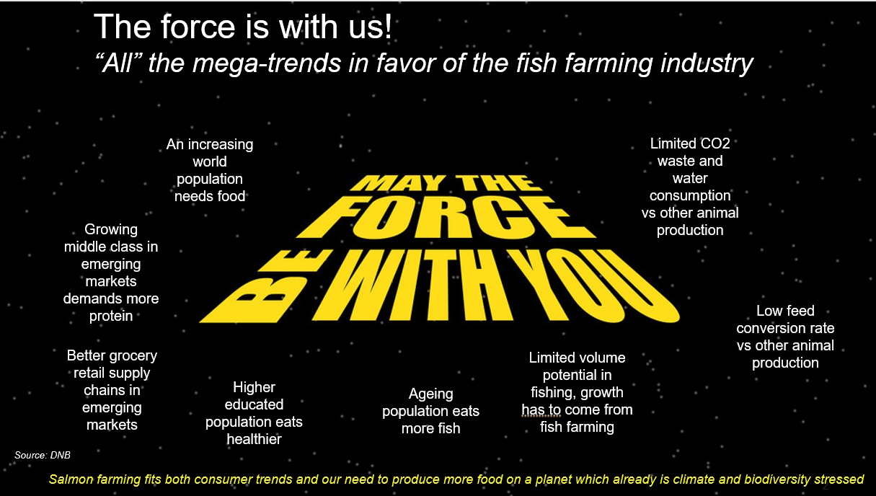

Slide 3
Agenda
Sustainability issues in salmon
Green and sustainability linked financing

Slide 4
Direct link sustainability & profitability in salmon farming
Short & mid term
Cost
Long term
License to grow
Price achievement
Volume
License to operate
Bio-security
Social license

Slide 5
Sustainability a key cost driver
Cost per kg, NOK. Change since 2005
Source: Bård Misund, University of Stavanger

Slide 6
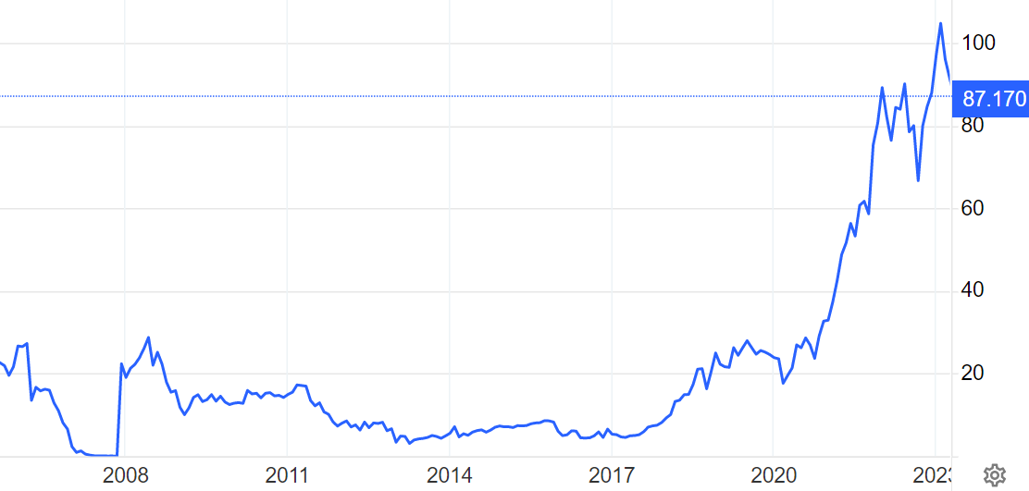
The sustainability cost until now has been related to the marine environment
Carbon the next big cost item?
The cost of green house gas emissions. EUR/ton (EU carbon permits)
EUR/ton at 100 would add NOK/kg 5 to the cost of salmon delivered by truck to Europe from Norway. For salmon delivered by air to the US or Asia, it would add NOK/kg 20-30 in cost.
Meat producers would be hit harder than salmon farmers however for the actual product (but on the other hand they don’t tend to fly the product to the customer).
Source: Tradingeconoimcs
Notes:
EU Carbon Permits - 2023 Data - 2005-2022 Historical - 2024 Forecast - Price - Quote (tradingeconomics.com)

Slide 7
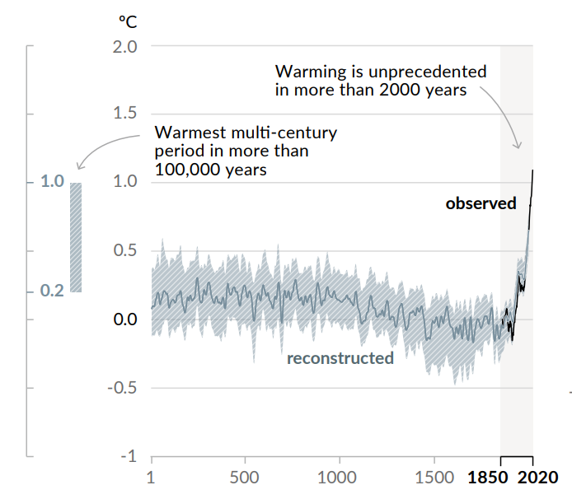
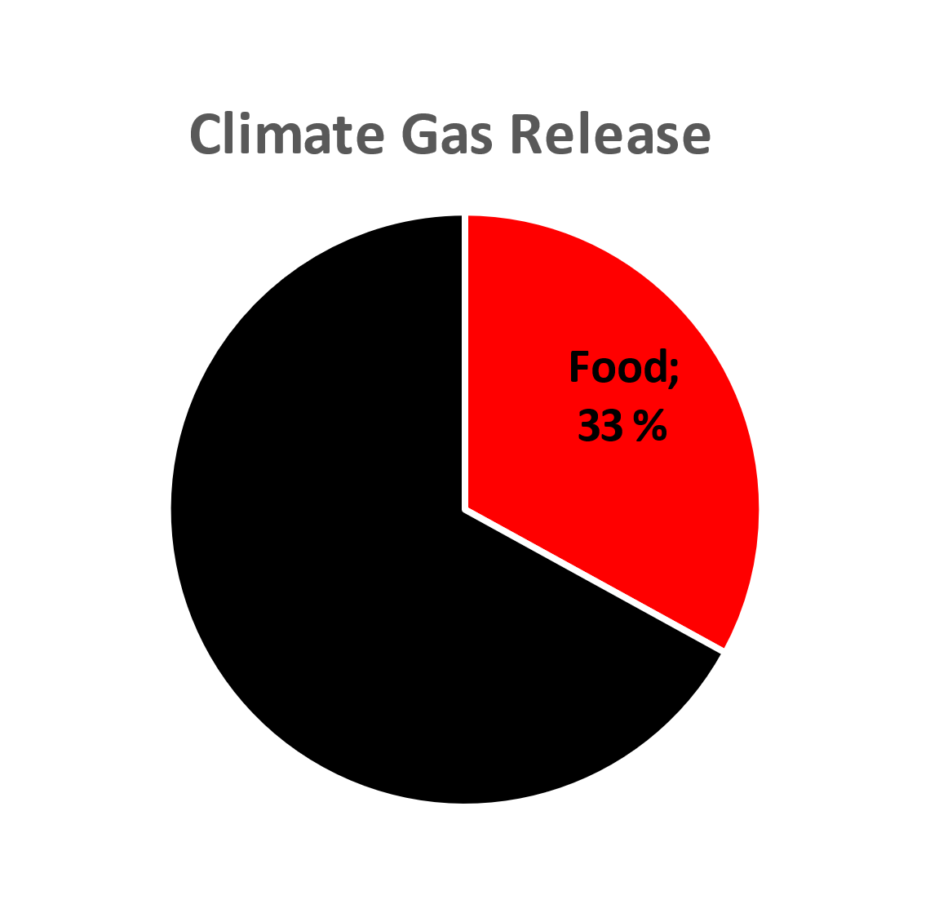
Source: IPCC, Nature Food

Slide 8
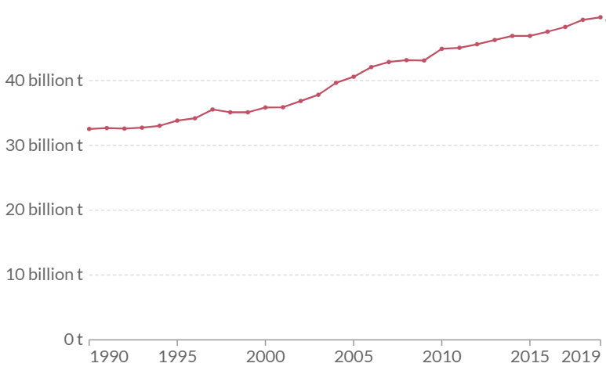
No food system change = no Net Zero!
Greenhouse gas
emissions, billion tons
25
If all other sectors achieve net zero, but we continue to produce food the way we do today, we will reduce green house gas emissions by only half
0
Source: DNB, Our World in Data, Bill Gates

Slide 9
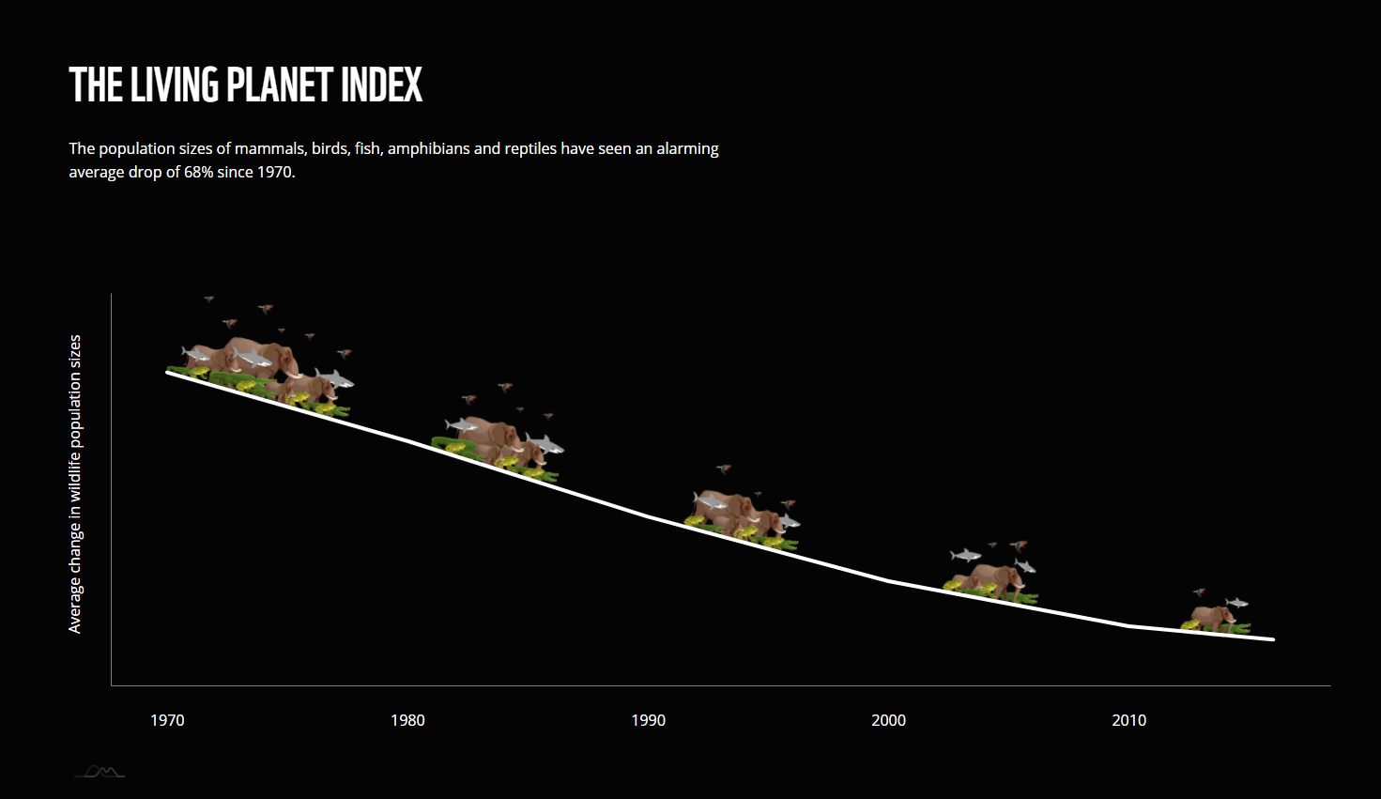
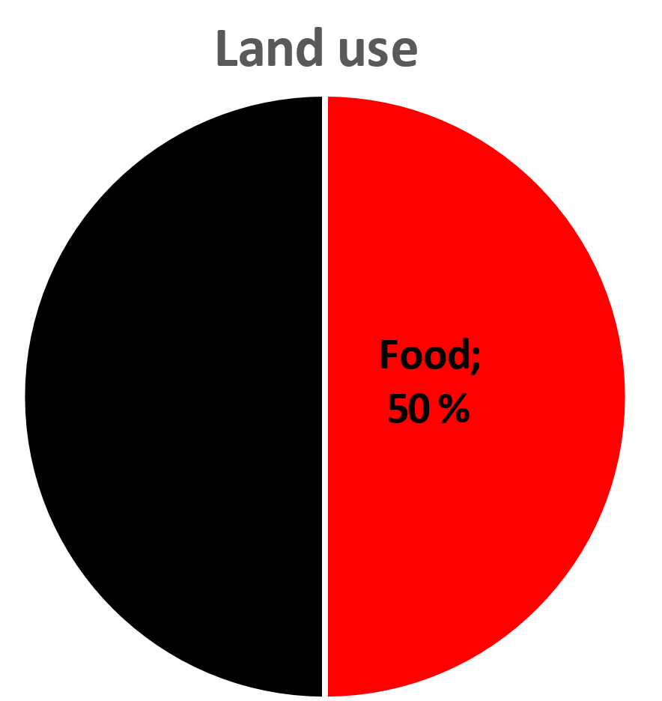
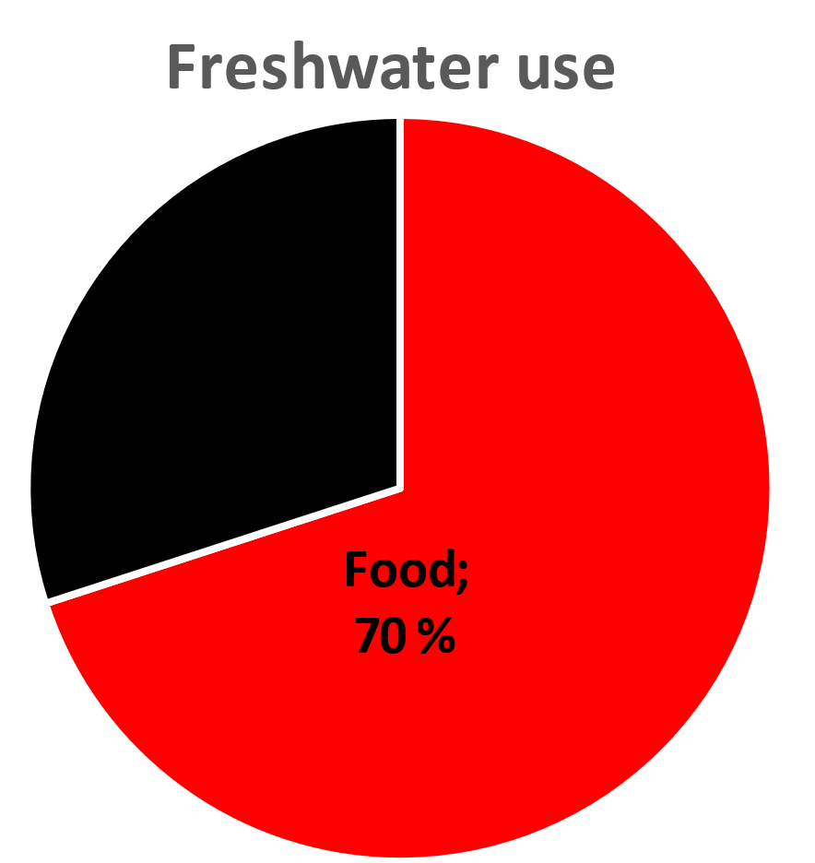
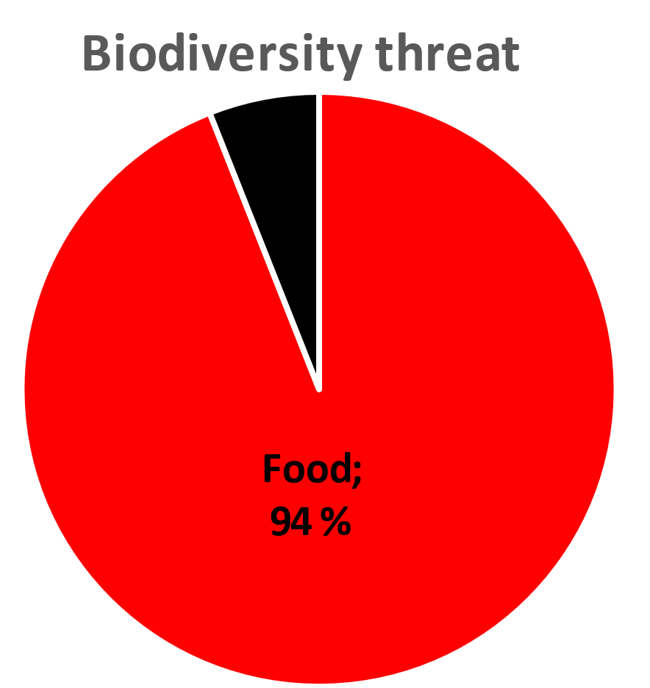
Source: WWF, Sustainalytics

Slide 10

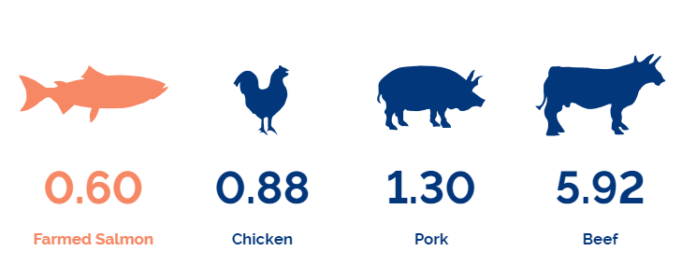
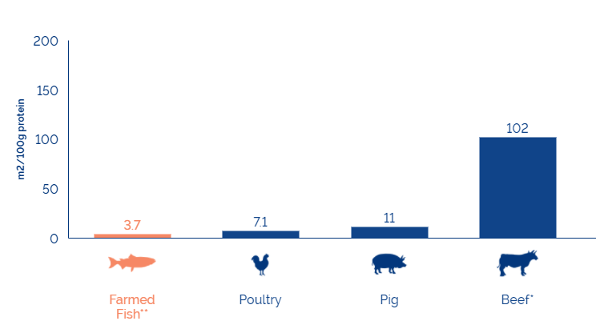
«Energy Transition» vs «Food Transition»
Carbon footprint (kg CO2-eq per 40 g serving)
Land needed to produce 100 grams of edible protein
Source: GSI

Slide 11
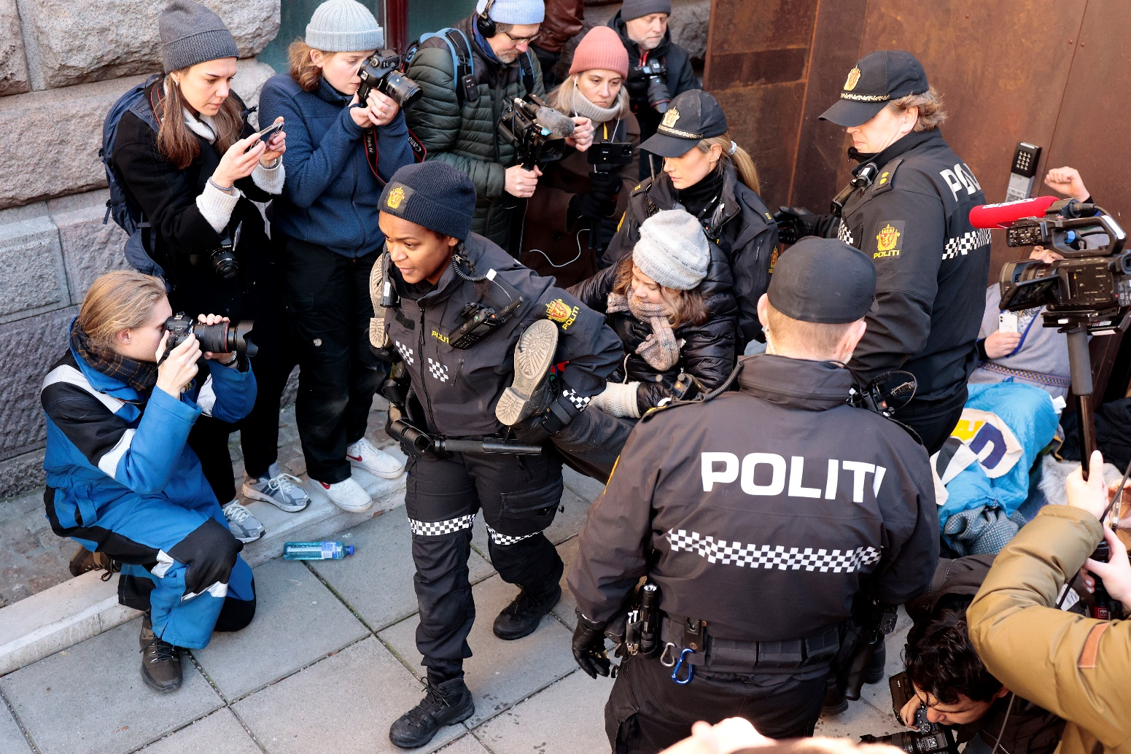
DNSH!
DNSH = Do No Significant Harm

Slide 12
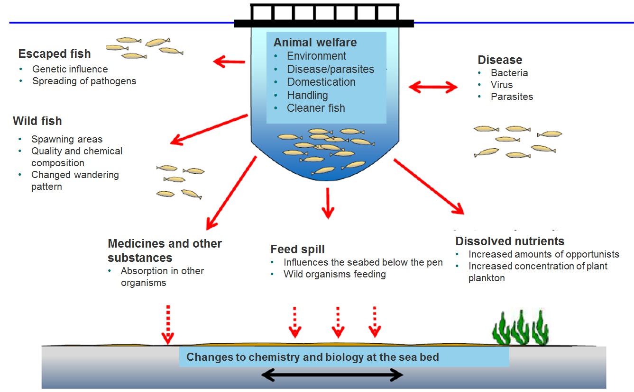
Traditional sustainability focus: local
Salmon’s DNSH danger zone
=
Local footprint
+
Impact on indigenous people
+
Antibiotics
+
Fish welfare
Source: Fiskeridirektoratet (DNB translation from Norwegian)

Slide 13
What society expects from companies
Save the world
Stop to exist
Continue to do what they do – only better

Slide 14
Agenda
Sustainability issues in salmon
Green and sustainability linked financing

Slide 15
Why do banks care about ESG?
They have no choice: a tool for government policy
ESG risk is financial risk
Own reputation and risk profile

Slide 16
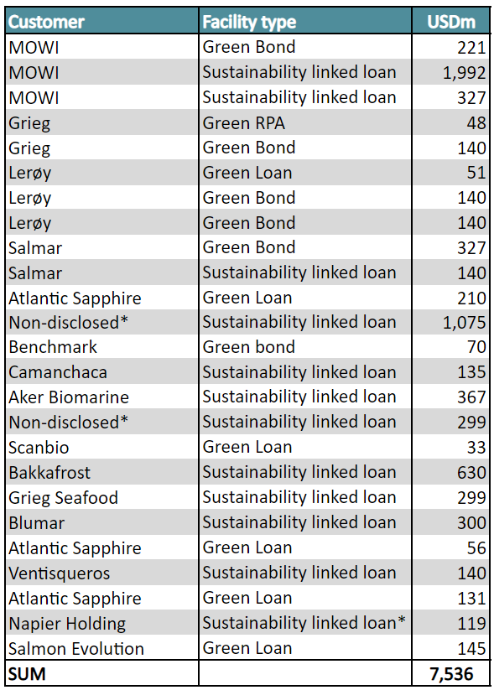
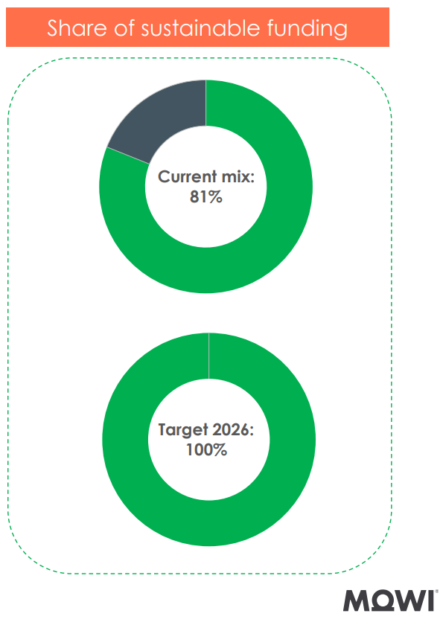
Green & sustainability linked financing
Transactions DNB has been involved in
Green bond or loan:
The money goes to a specific project which is classified as green
Sustainability linked bond or loan:
The money goes to general corporate purposes, margin linked to performance vs KPIs

Slide 17
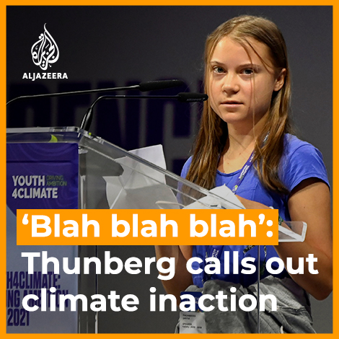

Slide 18
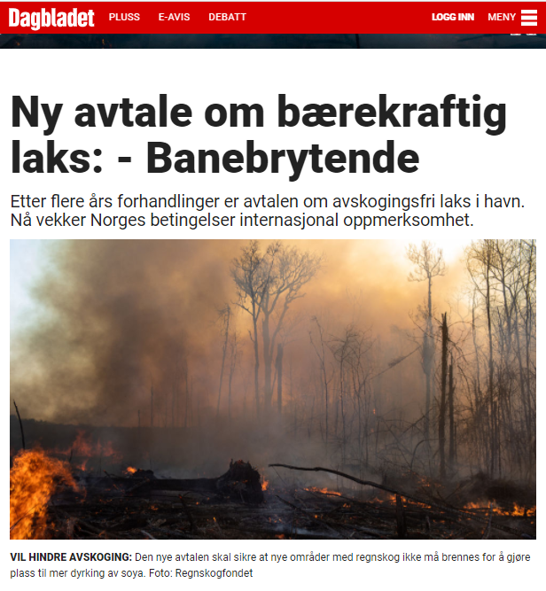
We see this voluntary sector-wide commitment as a benchmark to inspire other global animal protein sectors.
-WWF Brazil
The Brazilian soy suppliers and the Norwegian salmon industry show true leadership and set the new bar for sustainable supply chains. This historic commitment by their Brazilian soy suppliers will be a game changer for the sustainability standard for global supply chains. Global pork, poultry and beef producers are lagging behind, by still allowing deforestation in their supply chain. To stop being complicit in deforestation, the meat industry must follow suit and require their suppliers to become fully deforestation-free.
-The Norwegian Rainforest Foundation
18

Slide 19
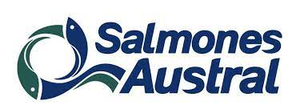
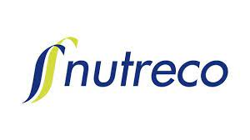
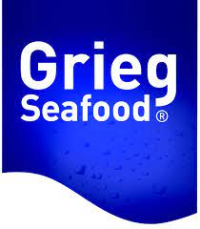


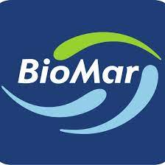
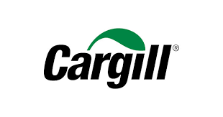



Strong climate gas commitments
Science Based Targets
Source: Science Based Targets

Slide 20
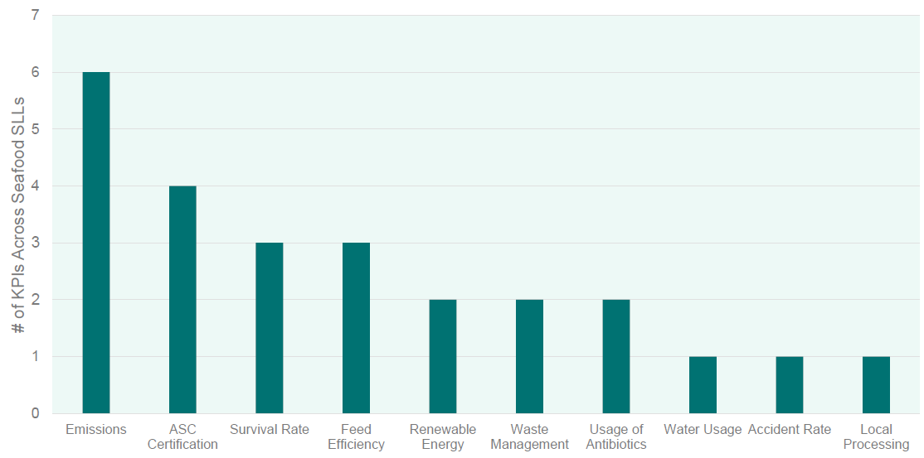
KPIs in salmon farming STL financing
Common to use 3-5 KPIs in a STL loan
Source: DNB

Slide 21
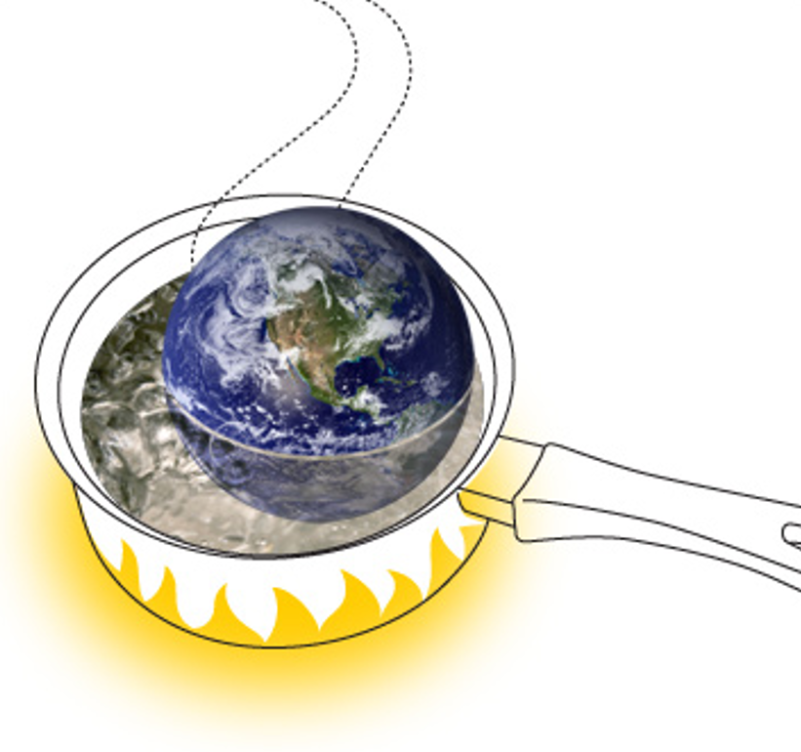

What’s in it for me?
Financing cost doesn’t decline on average just because we boil the planet

Slide 22
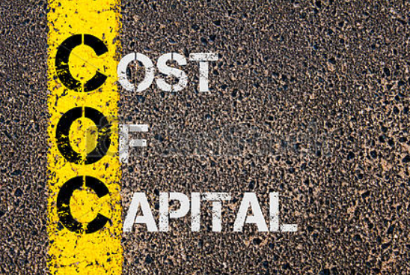



From cost of capital to access to capital

Slide 23


Slide 24
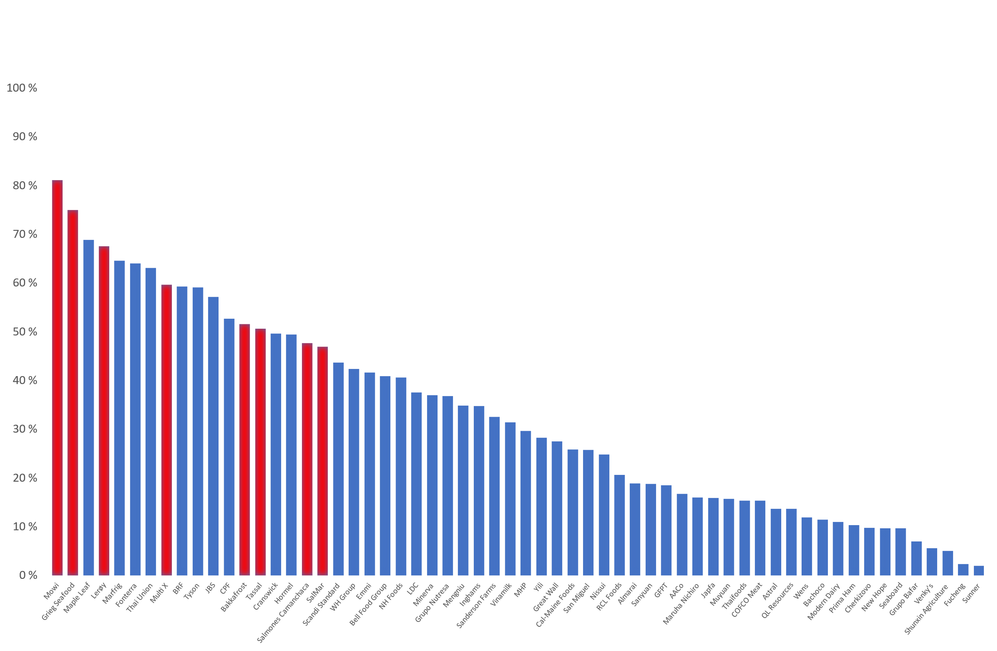





The Coller FAIRR Protein Producer Index
Low risk
Medium Risk
High risk
Source: Coller FAIRR

Slide 25
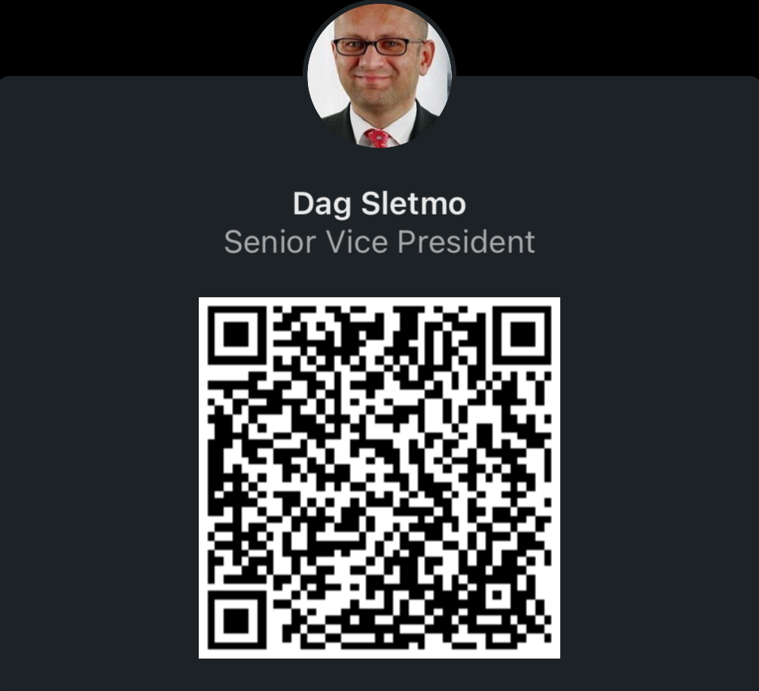

DNB Bank is a global seafood player
Atlantic Cod
Atlantic Herring
Gothenburg
Atlantic Salmon
Stockholm
Copenhagen
Oslo
Helsinki
Atlantic Salmon
Atlantic Salmon
London
Warsaw
Hamburg
Alaska Pollock
New York
Athens
Shanghai
Mumbai
Anchovy
Singapore
Chilean Jack Mackerel
Rio De Janeiro
Headquarters
Santiago
Geo & Regional Hubs
Atlantic Salmon
Branches & Representative
Offices
Banks with 17 of the top 20 salmon farmers globally
Global leading seafood bank, presence in key markets, 10 USD billion of total exposure
In-depth industry knowledge developed through close long-term relationships with key customers
Dedicated seafood team with an international footprint and strong track record as a banking partner and advisor
Leading arranger of debt in seafood sector, and a full range of Investment Banking services offered

